Slide 1
Special Convective Initiation Project
Tilden P. Meyers
NOAA/OAR/ARL/ATDD
June 21, 2016

Slide 2
Leveraging Observations and Models to Improve Predictions of CI
To develop a probabilistic 0 – 4 hour product using machine learning approaches with near real-time observations and model products
Conduct field campaigns to investigate triggers for CI and provide data for model evaluation
Use models to evaluate the relevant scales of surface heterogeneity that are significant for CI

Slide 3
Statement of the Problem
Predicting when and where summertime convection will occur in the Southeastern U.S. is notoriously difficult. For atmospherically- favorable environments, CI events are thought to be triggered by subtle forcings, such as changes in land use and/or surface fluxes of heat.

Slide 4
NOAA-sponsored effort
Supported by the Disaster Relief Appropriations Act of 2013, commonly referred to as the Sandy Supplemental.
This research was part of a coordinated program of activities to improve NOAA information and services to the public in preparation for, response to, and recovery from other high-impact events.

Slide 5
Observations

Slide 6
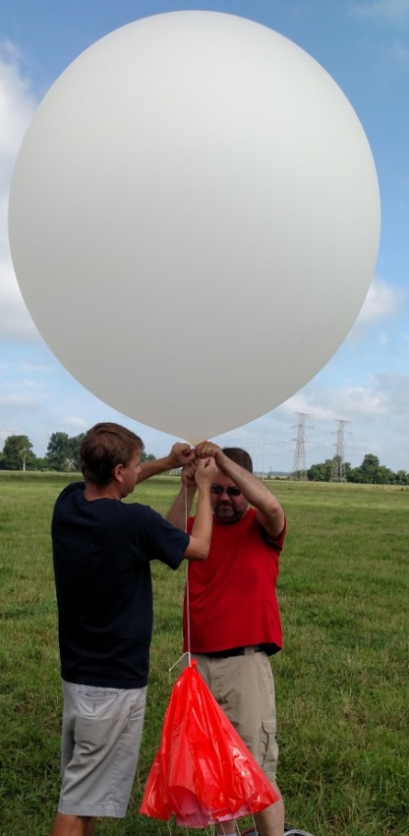
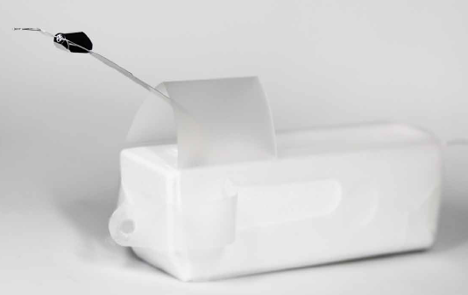
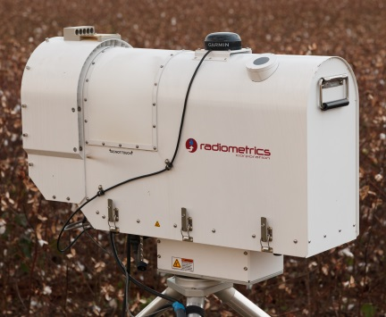
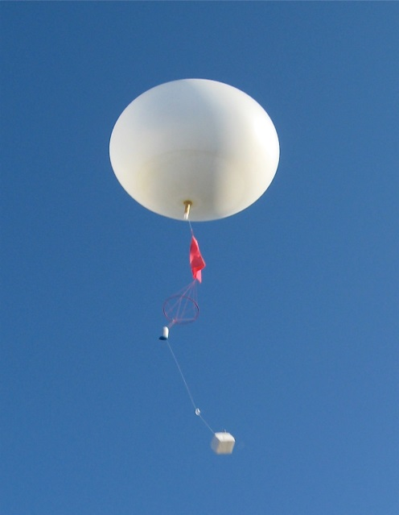
Rawinsondes
Microwave Profiler
GRAW DFM-09 rawinsondes
Ascent rate: ~3 m s⁻¹
Vertical resolution: ~20 m
Maximum altitude: ~25 km
Output: T, RH, vapor density, liquid water
Sampling frequency: ~2.5 min
Range: 10 km
Vertical resolution:
0-500 m agl: 50 m
500-2000 m agl: 100 m
2000-10000 m agl: 250 m

Slide 7
Leosphere WindCube 100s Lidar
Doppler Beam Swinging (DBS) scans every 7 s
Range: 5 km (typically 2 km)
Vertical resolution: 50 m
Data coverage (16 Jul – 16 Sep 2015):
All: 82%
CNR>-30 dB: 74%
Height (m agl)
Time (LST)
Time (LST)

Slide 8
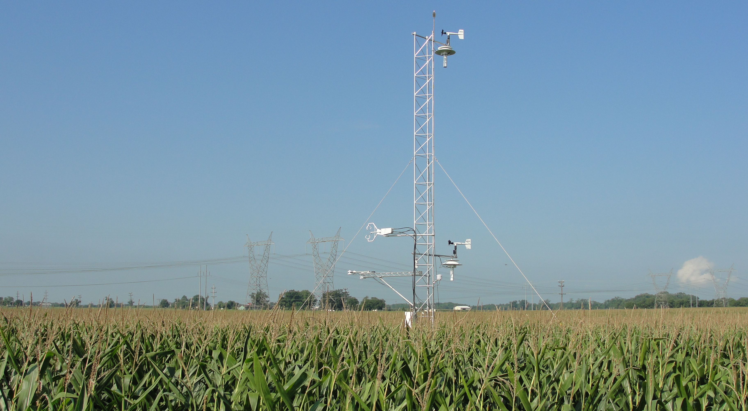
Micromet Tower System

Slide 9
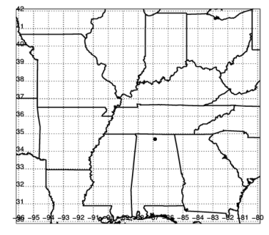
Observations: 2014 and 2015
Field Site:
Belle Mina, AL
2014 Deployment
4 10 m flux towers (N. Grass, S. Grass, Corn crop, Soybean crop)
MWR
Mid Jul – mid Oct
2015 Deployment
1 10 m flux tower (S. grass)
MWR
Wind lidar
Mid Jul – mid Nov

Slide 10
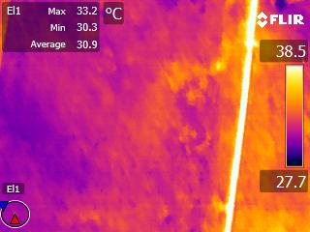
100 m

Slide 11
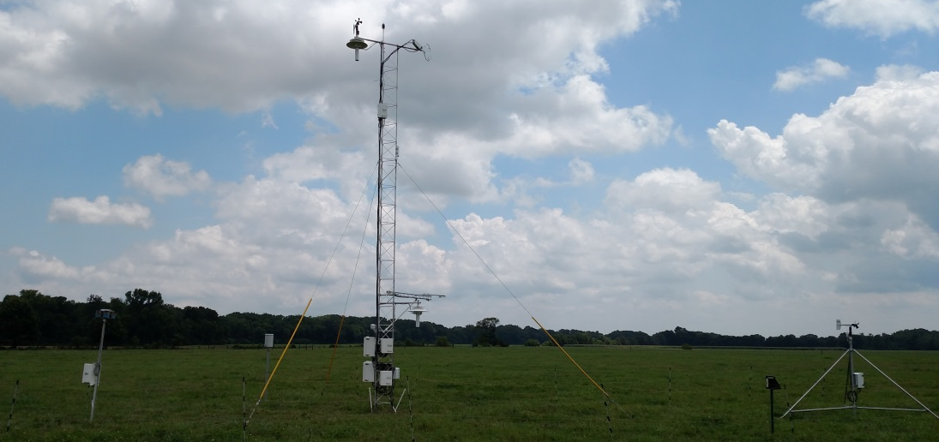
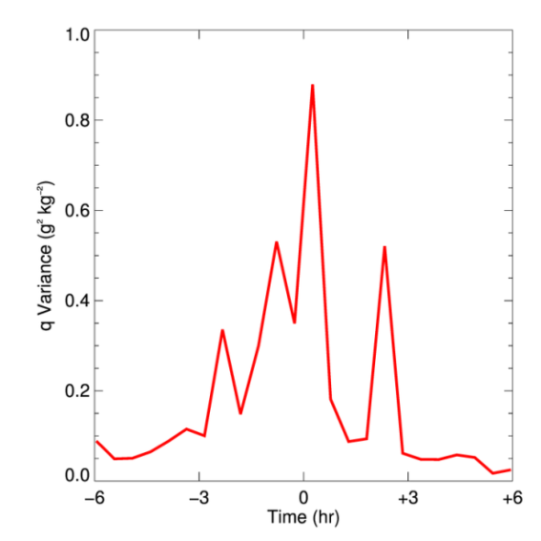
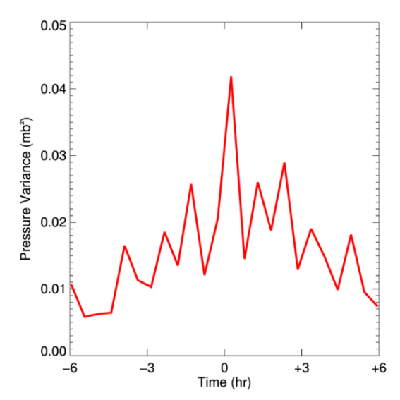
Observations
30 min variance signatures show consistent trends prior to convective events
30 min variances of 1 min data ±6 h from CI (N=7)
Variance in q (g² kg⁻²)
Variance in P (mb²)
Time from CI (h)
Time from CI (h)

Slide 12
Modeling

Slide 13
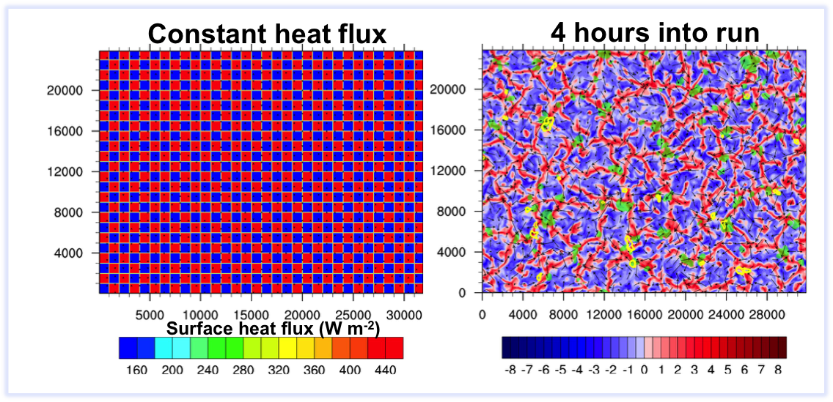
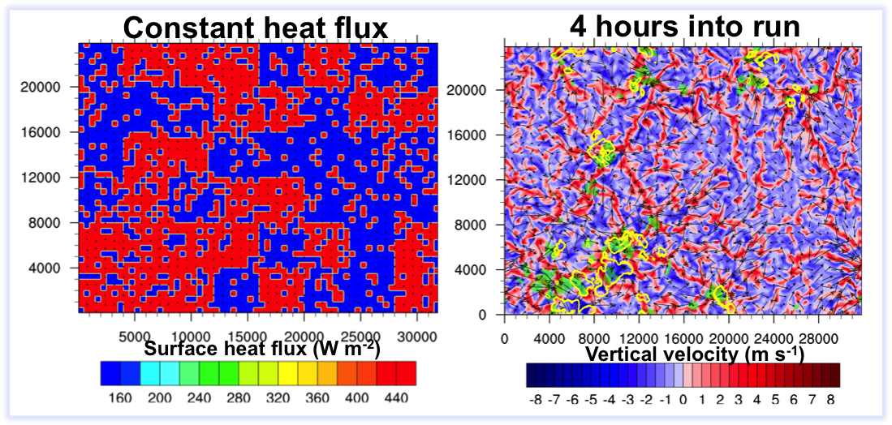
Hi-resolution modeling was used to examine what scales of surface flux heterogeneity are needed to trigger CI
Vertical velocity (m s⁻¹)
1 km
“CI”
4 km

Slide 14
Modeling (hi-resolution)
At scales > 2 km, the surface flux pattern is manifest in boundary layer circulations and resulting cumulus formation and convective initiation.

Slide 15
Forecast
University of Alabama-Huntsville (Dr. John Mecikalski)

Slide 16
Develop a probabilistic 1-4 hour CI nowcast product (30 min update, ~5 km resolution gridded product) using machine learning methods
Mecikalski et al./CWG Meeting 2016

Slide 17
Approach
CI Event detection: Define / detect CI as a ≥ 35 dBZ intensity radar echo at the surface or –10° C level at time t h. Delineate a 20 km radius Region Of Interest (ROI) centered on the CI event
Training database: Characterize pre-thunderstorm atmospheric and land surface conditions for the ROI for times t, t-1, t-2, t-3 and t-4 h using NASA and NOAA satellite remote sensing fields as well as NOAA Rapid Update model fields
Machine learning: Develop statistical models using machine learning techniques (e.g. Random Forest, Support Vector Machines, Logistic Regression) that may relate background conditions with occurrence / non-occurrence of CI within an ROI
Generate CI predictions for 1, 2, 3 and 4 hours into the future

Slide 18
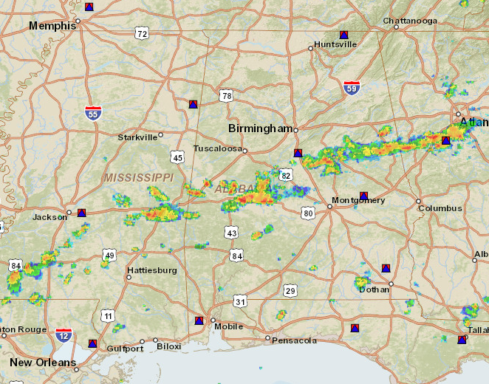
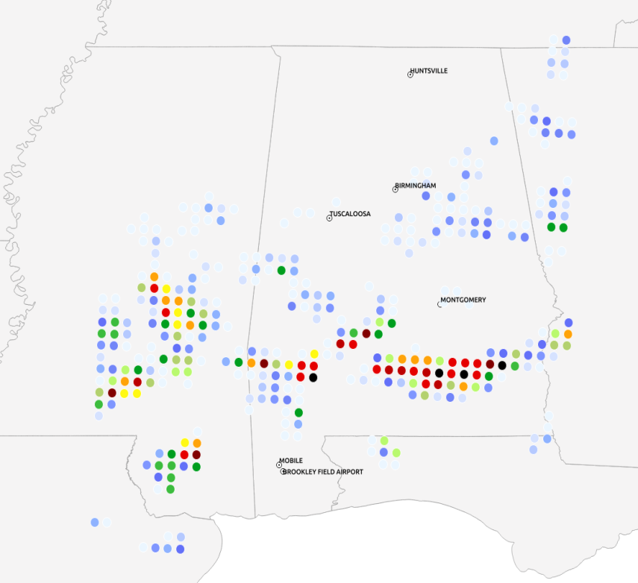
Forecast
CI Probability for 7/24/2014
NEXRAD Radar composite
(CI nowcast)
Mecikalski et al./CWG Meeting 2016

Slide 19
Quality, Relevance, Performance
Data sets used for Planetary Boundary Layer (PBL) model evaluation and testing
Evaluation of new technology for probing the boundary layer (e.g. microwave profiler)
Development of forecasting tools for National Weather Service/Weather Forecasting Offices

Slide 20
Quality, Relevance, Performance…cont
Allowed for easy transition to support VORTEX-SE study
Exploring new ways to observe lower PBL with Unmanned Aircraft System
Developing new techniques to map surface heat fluxes using surface temperature derived from infrared imagery

